Slide 1
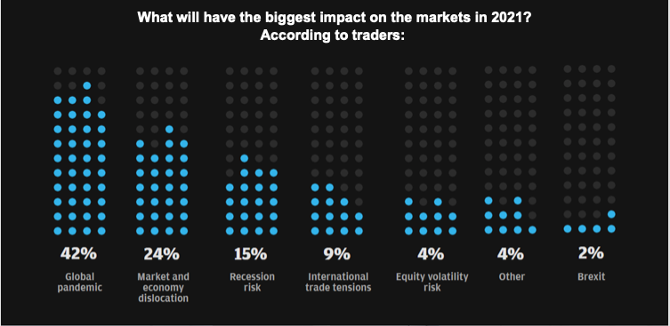

Slide 2
U.S. Residential Real Estate Analysis in the midst Global Pandemic
Analysis by:
Susan F, Valeriia D, Wes S & Yasir M

Slide 3



Scope
The goal of the project is to help the investors decide if COVID - 19 caused a “Buyer’s Market” or a “Seller’s Market” in major cities, especially New York City.
Scope of the Project is to Answer the following Questions:
Real Estate impact post COVID - 19
Correlation of Major ETFs with Actual Home Sales
Expectations v/s. Reality

Slide 4
Thought Process
Data Extracts
U.S. Real Estate market is one of the best indicators of the Economic cycle. Our observations focus on the relationship between buyers and sellers in the Real Estate market.
Almost a decade ago U.S. economy was on the verge of a collapse due to the housing market.
COVID - 19 caused a direct threat to the US housing market and paved way for some opportunities to arise “inorganically”, thanks to the US Govt directly controlling the Fannie Mae and Freddie Mac and the mortgage payment deferment option available to anyone owning real-estate.
Real Estate is one of the best indicators of the Economic cycle. Hence, we wanted to observe a relationship between buyers and sellers in the Real Estate market using the data available.
The data for US Price Index was extract for Zillow Home Value Index (ZHVI): A smoothed, seasonally adjusted measure of the typical home value and market changes across US.
The StreetEasy Price indices are used to track changes in resale prices of single-family homes, for Manhattan, Brooklyn, and Queens.
Four major ETFs extracts from Yahoo:
iShares US Real Estate ETF - (IVR)
Dow Jones Ind Avg ETF Trust - (DIA)
Vornado Realty Trust - (VNO)
S&P 500 ETF Trust - (SPY)

Slide 5
Data Cleansing
Zillow Home Value Index (ZHVI) was extracted from Zillow and rationalized using CSV link to a consumable data frame in Python notebook for seeing the trends in U.S. as a whole
The StreetEasy Price index data extract was used to narrow down on Manhattan, Brooklyn, and Queens.
Four major ETFs were extracted Yahoo Finance (APIs have a 6 Months Constraint on the data) to compare and contrast ZHVI for the entire U.S.
iShares US Real Estate ETF
SPDR Dow Jones Industrial Average ETF Trust
Vornado Realty Trust
SPDR S&P 500 ETF Trust
Ran the betas of Real Estate stocks, the US housing price index versus the SPDR S&P 500 ETF Trust
Ran Monte Carlo Simulation to predict how much investors would make in the 5 years following 2021

Slide 6
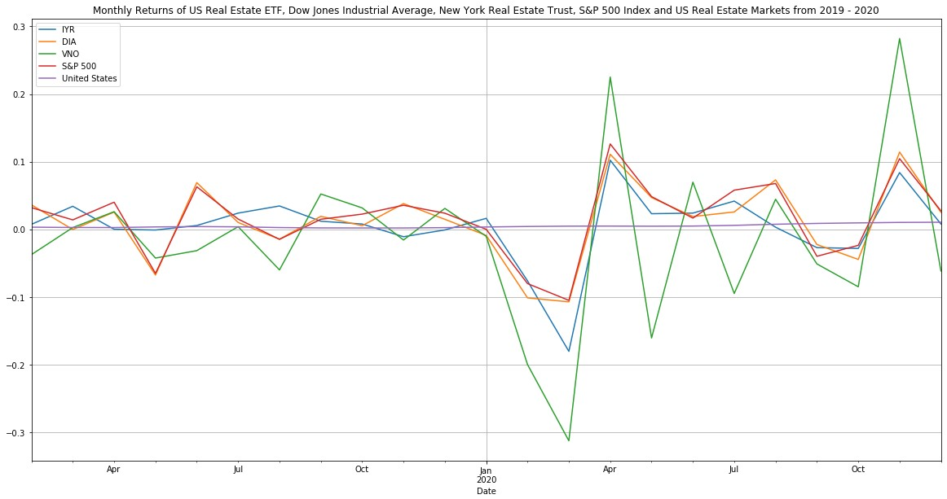
Combined Monthly Returns of ETFs and US Housing Data

Slide 7

Betas | Correlation| Monte Carlo - Simulation

Slide 8
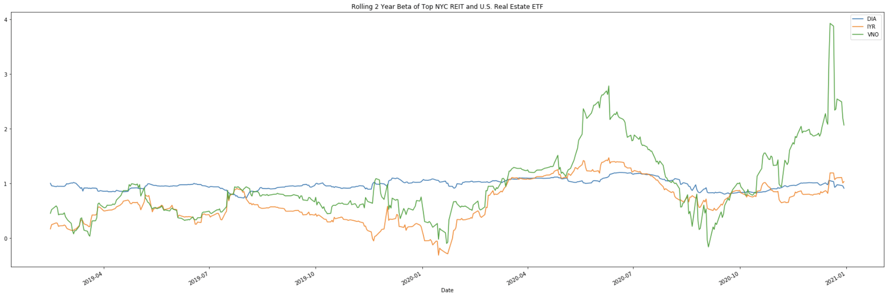
Betas and Correlation
By the end of this section, you will notice:
The volatility of Real Estate stocks increases after COVID strikes.
The Inventory of houses for sale on Zillow increased in major cities, and the Average Sales Price decreased
The data should also indicate that Real Estate in suburban areas demonstrated an inverse relationship compared to major city RE.

Slide 9
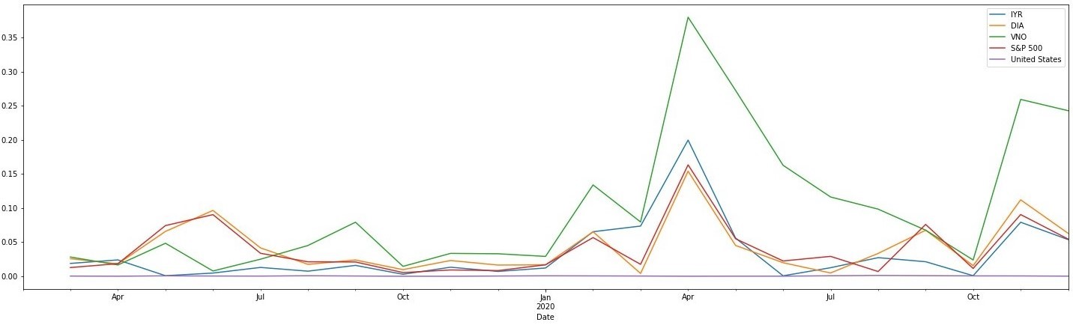
Beta Plot of ETFs

Slide 10
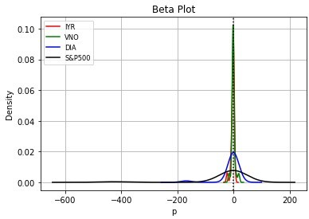
Rolling Standard Deviation
The iShares US Real Estate ETF and Vornado Realty Trust has a higher beta dispersion compared to the Dow Jones ETF Trust and the S&P 500

Slide 11


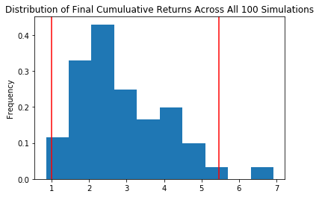
The problem with the NYC Real Estate market was the mass exodus of people that didn’t need to stay in the city, or didn’t want to live in the city due to the dangerous environment caused by the extremely contagious COVID-19 virus
The Cause of the Opportunity
Monte Carlo Simulation
Even weighted portfolio, 5 year projection
95% confidence interval that $100,000 would return between $99,654 and $545,786

Slide 12
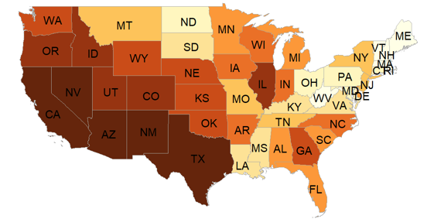
Maps and
Plots

Slide 13
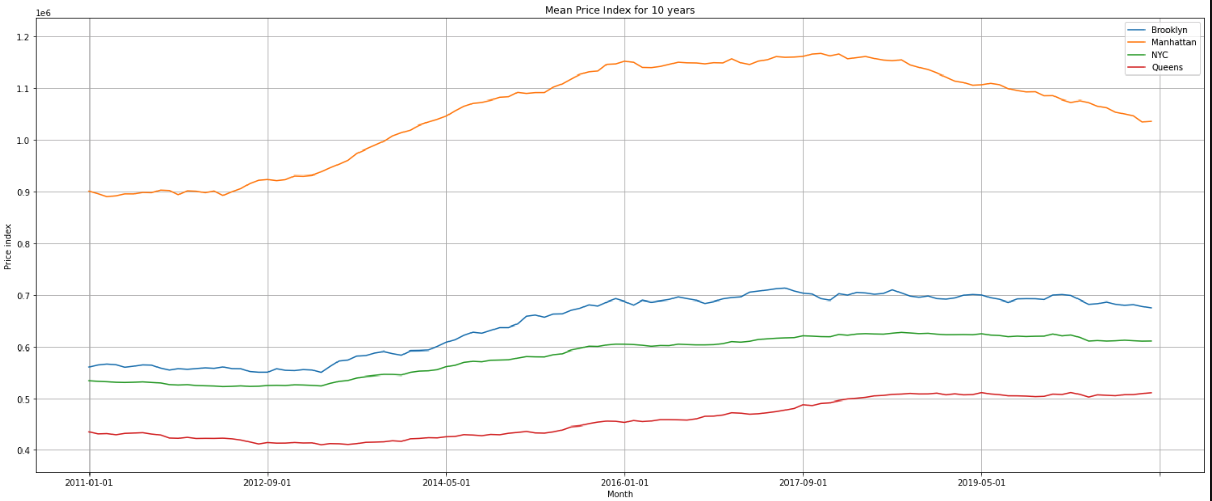
Development of RE prices in NYC and 3 of its boroughs 2010 - 2020
In our analysis we differentiated between New York City (NYC) and three of its
boroughs. Visibly Manhattan stands out both as for price levels and growth
dynamics

Slide 14
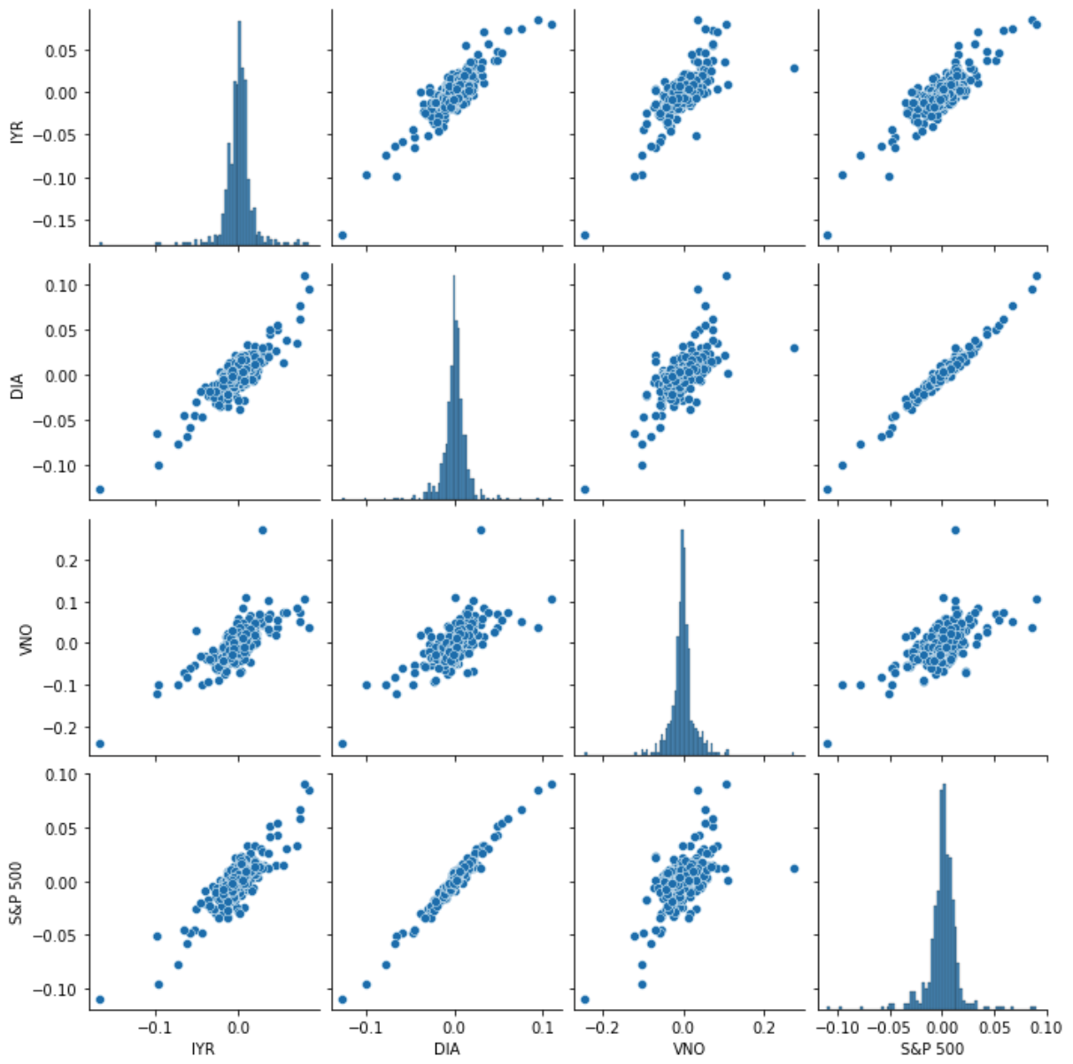
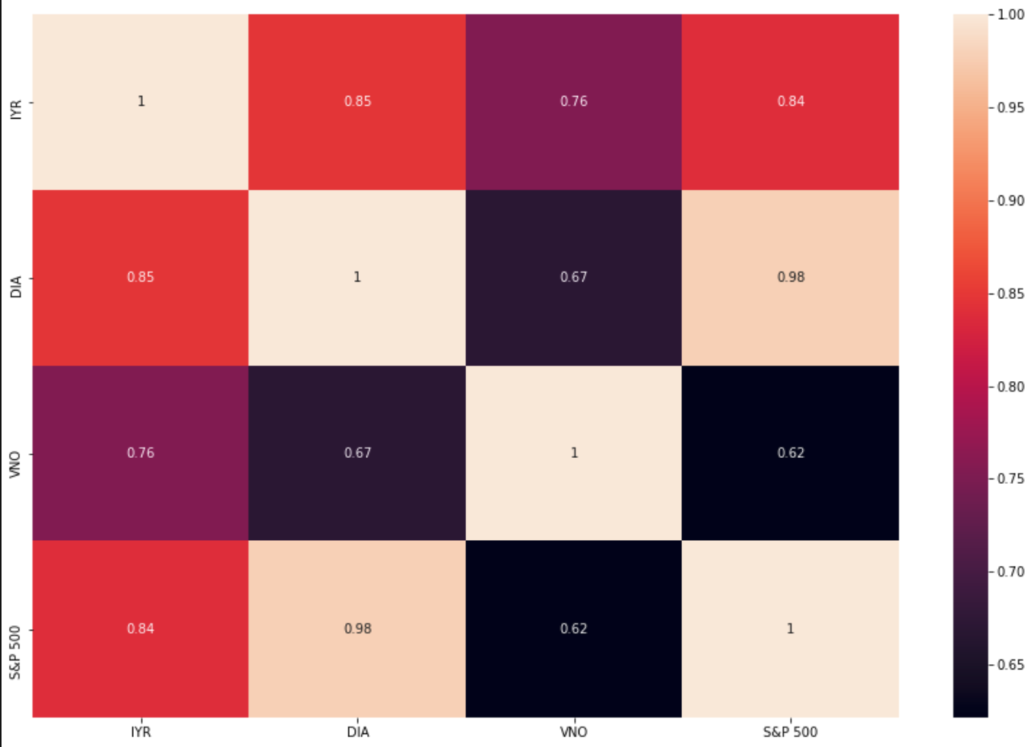
VNO, with a core focus on New York City, shows the lowest correlation to the overall market (0.62), whilst the wider spread IYR correlates more closely with the overall market (0.84/S&P & 0.85/DIA).

Slide 15
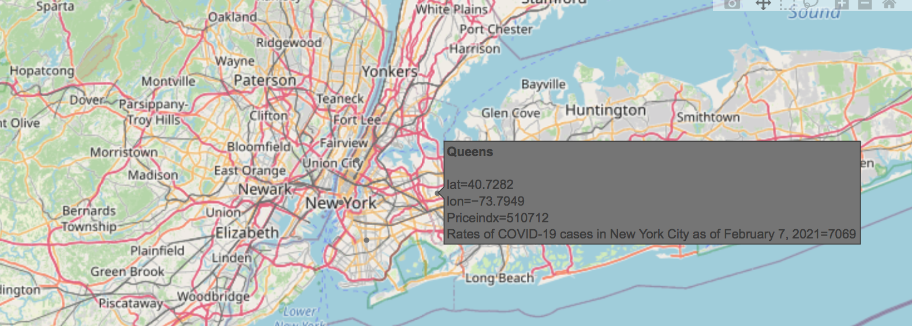
4 boroughs of NYC with rates of Covid-19 cases as of February 7, 2021

Slide 16
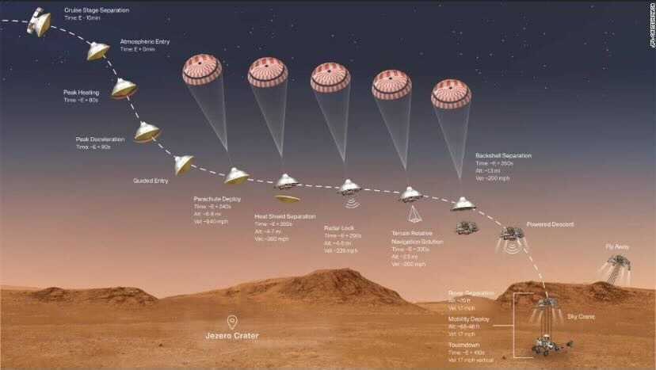
Progression to
Landing

Slide 17
Progression
December 2019
October 2020
March 2020
December 2020
First cases and stories of COVID spread
The election sends the country into frenzy, markets climbing back
2019 |  |  |  | 2020
Government shuts down economy, stock market takes a dive
US Stock market reaches 2019 highs and RE index has largely recovered

Slide 18
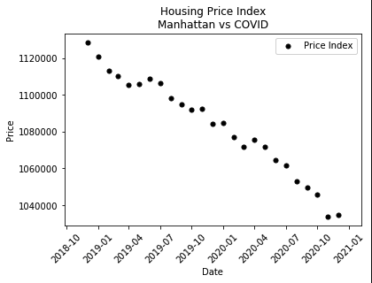
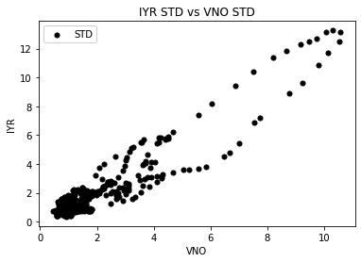
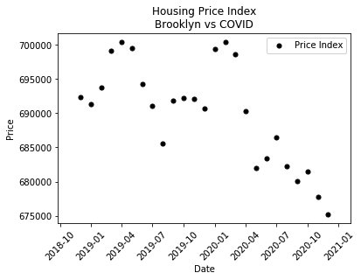
Conclusion
The plots we generated indicate that the NYC housing market became more volatile and less valuable once Covid hit:
Manhattan Housing Market suffered compared to the US Market
The decrease in major cities was more than offset by suburban market increases
We were able to gather enough information on NYC Metro area
Vornado NYC REIT riskier than the US RE ETF

Slide 19
Phase 2
Next Steps...
Multiple Variable regression & Prediction Model
In-depth analyses of all US Metro housing markets
Build out Interactive Dashboard with better visuals
http://localhost:12345

Slide 20
What issues did we ran into?
Collecting Cleaning
We had trouble finding up-to-date datasets for Real Estate that were in desirable formats
Lack of planning
Could have come up with a thesis on the day one
Absent sudo-coding
Technical skills
Had we spent less time data-cleaning or trying to visualize, the rest of the team could have been researching/building

Slide 21
Questions?

